Slide 1
Insurance Premium Prediction

Slide 2
Objective:
The objective of this initiative is to assess the financial needs based on individual health circumstances and develop a predictive solution for determining personal health insurance premiums.
Advantages:
Provides an annual estimate of the required amount based on personal health status.
Encourages individuals to prioritize their health within the insurance context.
Facilitates in determining health insurance premiums.

Slide 3
Architecture
Start
Data Fetching
EDA
Data Cleaning
Feature Engineering
Model Building
Model Testing
Streamlit Setup
Deployment

Slide 4
Data Collection and validation
The dataset was sourced from the Kaggle competition platform.
The data types of columns were examined to ensure accuracy, and any discrepancies were rectified.
Null values or missing information in dataset columns were identified and addressed.
Data preprocessing techniques were employed to prepare the dataset for analysis.
Exploratory data analysis was conducted to gain insights and understand patterns within the data.
Statistical methods were applied to validate the integrity of the dataset.

Slide 5
Model Training
Data Pre-processing:
Conduct exploratory data analysis (EDA) to uncover patterns within the data, such as distribution characteristics and the presence of outliers.
Identify and address any null values within the dataset through imputation techniques.
Encode categorical features or columns to facilitate their inclusion in analysis or modelling.
Apply StandardScaler to standardize the values and ensure consistency in scale across features.

Slide 6
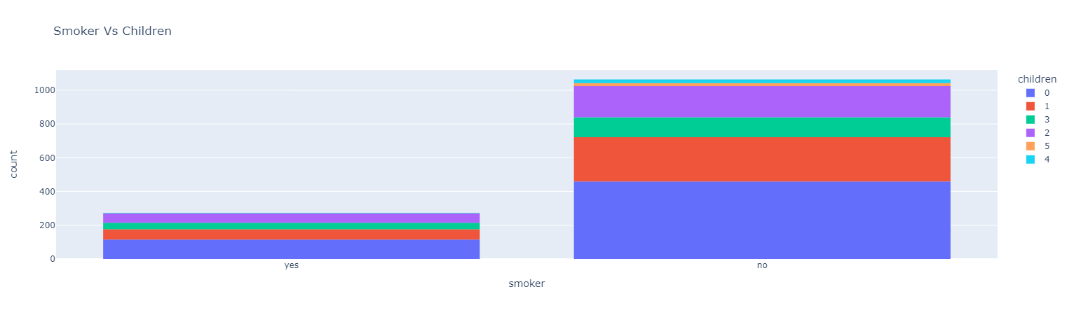
Countplot of Smoker Vs Children

Slide 7
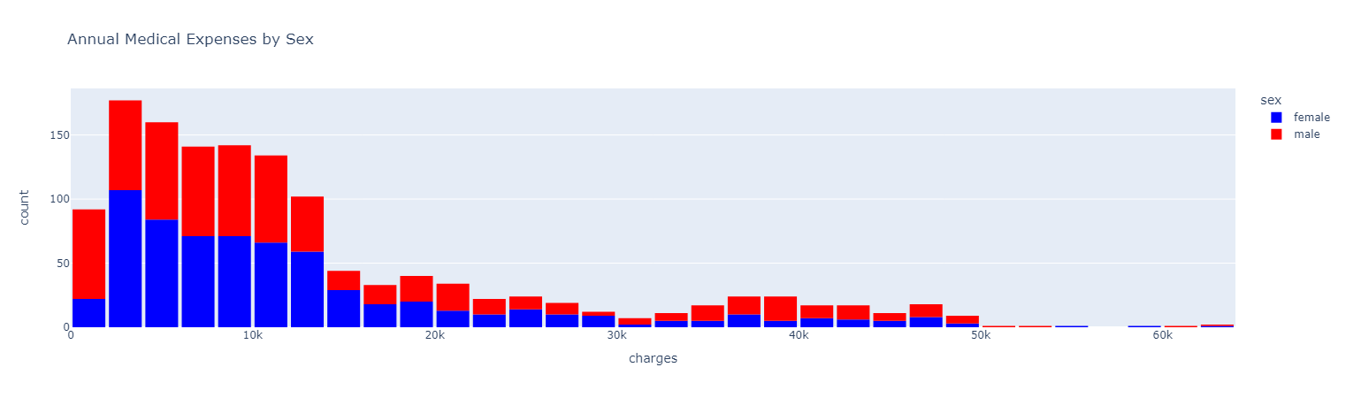
Medical Expenses by each Category of Sex

Slide 8
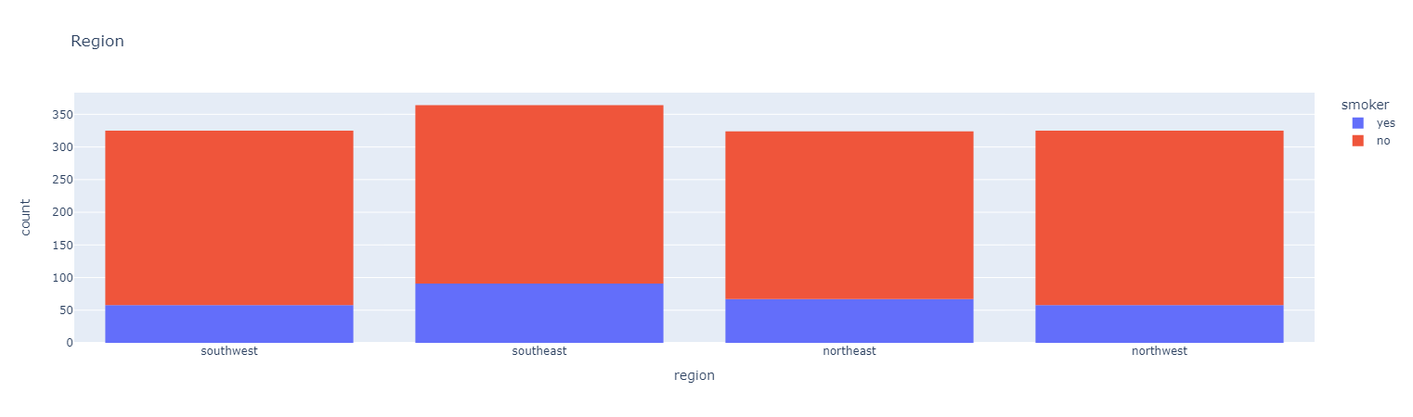
Count of Smokers in each Region

Slide 9
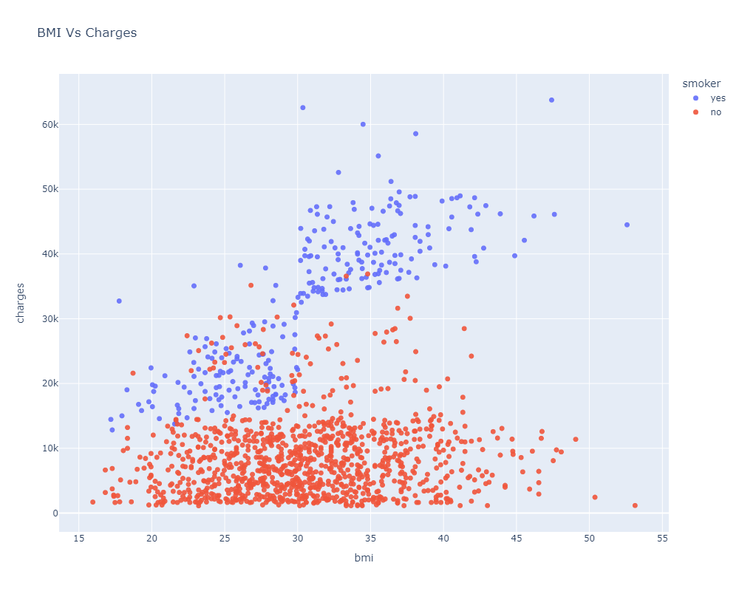
Scatterplot for Charges incurred by Smokers

Slide 10
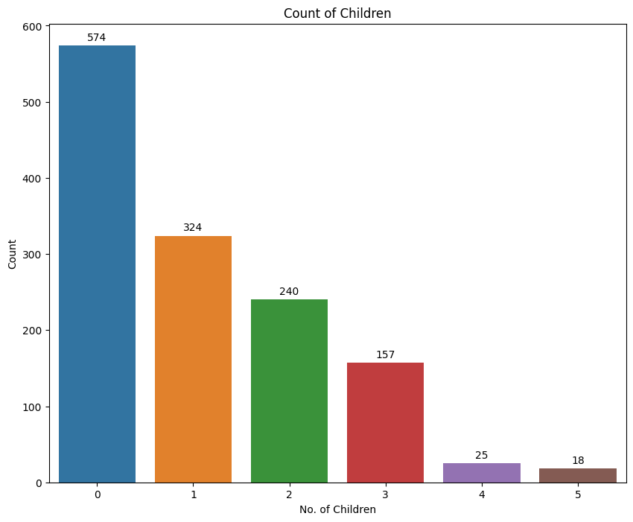
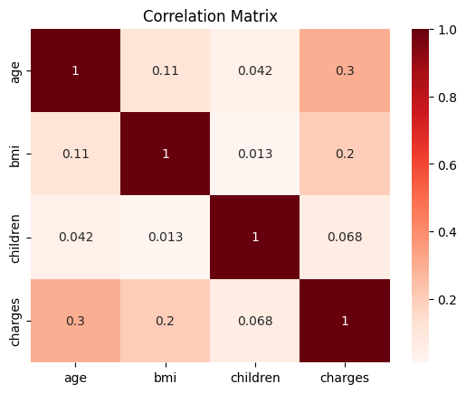
Count of Number of Children
Correlation Matrix

Slide 11
Model Selection
Post preprocessing and model training, we've identified the optimal model for premium prediction.
The model underwent training across various regression algorithms, including Linear Regression, Decision Trees, Random Forest, Gradient Boosting, Extreme Gradient Boosting, and K-Nearest Neighbors (KNN).
Following predictions, we'll assess the accuracy using evaluation metrics such as RMSE (Root Mean Squared Error) and r2_score (R-squared).

Slide 12
Predictions
Subsequently, all trained models were applied to validate the test set.
Pre-processing techniques were implemented on the test set to ensure consistency and comparability with the training data.
The model with the best RMSE and r2 score was selected and preserved for the development of an API tailored for premium prediction.
Further steps involved optimizing the selected model parameters to enhance its predictive performance.
Rigorous testing and validation procedures were conducted to ensure the reliability and accuracy of the API's premium predictions.
Extensive documentation and user-friendly interfaces were created to facilitate seamless integration and utilization of the API in various applications.

Slide 13
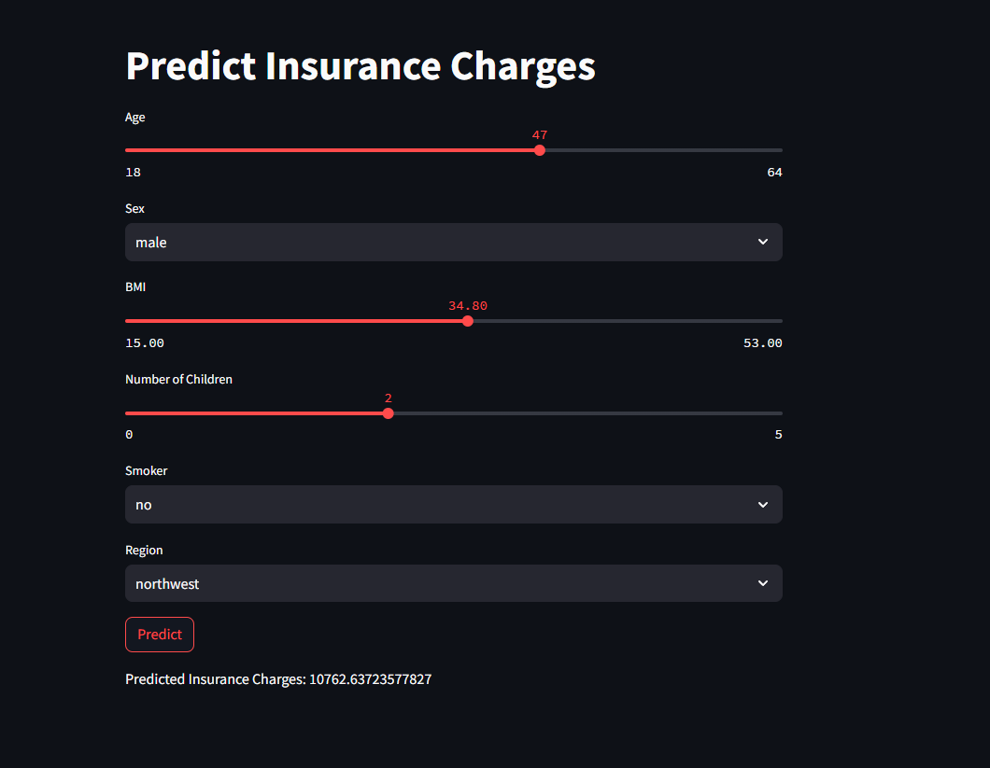
Streamlit Prediction Page

